Slide 1

Restorative Justice: A Promising Approach to Ending Child Sexual Abuse
Notes:
leona

Slide 2


Notes:
leona

Slide 3
Notes:
leona

Slide 4
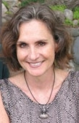
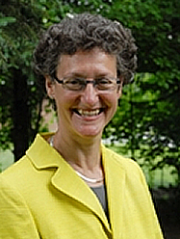
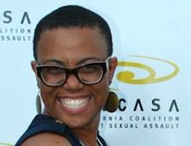
Series Co-Hosts
Cordelia Anderson
Leona Smith Di Faustino
Joan Tabachnick
Notes:
Introductions as to why each of us are part of this:)
Leona
Cordelia
Joan

Slide 5

Q’s for You
Answer on the left
Have you attended prior ECSA?
Notes:
Cordelia

Slide 6
Q’s for You
Answer on the left
Does your work involve a Restorative Justice Approach?
Notes:
Cordelia

Slide 7
What are you hoping to get out of this webinar?
Notes:
cordelia

Slide 8
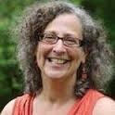
Why Restorative Justice?
“How we respond to sexual abuse can create the societal and cultural motivation to prevent child sexual abuse.”
-- Alisa Klein
Notes:
joan

Slide 9
Learning Objectives
Understand the elements of restorative justice
Learn about the role of survivors
Understand circle process and its value within South Asian and other communities
Notes:
Joan
Understand the elements of restorative justice processes and models
Learn about the role of survivors in restorative justice
Understand circle process and its value for breaking silence within South Asian and other immigrant/communities of color

Slide 10
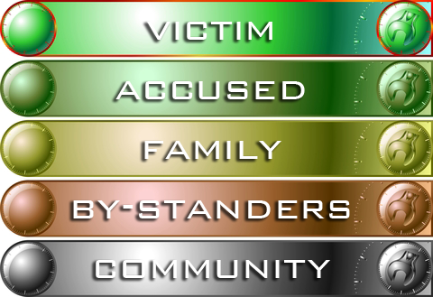
ALL of Us are Affected
Notes:
joan

Slide 11

Pendulum is Swinging…
Notes:
Cordelia
Last 2 decades more and more awareness of child sexual abuse
Last 2 decades, more and more punitive approaches to sex offenders
These punitive approaches don’t work when families don’t want to report the abuse, when it is a child or young teen who is abusing, etc.

Slide 12
Survivor Voices
“Victims frequently want longer time for offenders because we haven’t given the anything else. Or because we don’t ask, we don’t know what they want. So [the system] gives them door Number One or Two, when what they really want is behind Door Number Three or Four.”
-- Mary Achilles
Notes:
cordelia

Slide 13
A Comparison of Each Model
Retributive Justice
What laws have been broken?
Who broke the law and committed the crime?
What punishment do they deserve?
Restorative Justice
Who has been hurt?
What are their needs?
Who is obligated and responsible for meeting those needs?
Notes:
Cordelia
Many circumstances RJ will NOT work (eg., sexual violence where sex offender does not take responsibility for actions)

Slide 14

Not a One Size Fits All Approach
Notes:
Cordelia
Each community has it’s own cultural traditions, expectations, strengths and challenges

Slide 15
Hollow Water First Nation
Endemic Sexual Violence
  Estimates of victims of CSA: three in four individuals.
  Estimates of abusers: one in three individuals.
  Virtually no community member untouched by victimization.
  Many offenders had been victims.
  All victims were acquainted with or related to their abusers.
Notes:
Joan

Slide 16
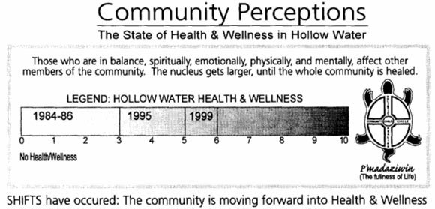
Hollow Water First Nation
Community Holistic Circle Healing (CHCH),
  Ojibwa tradition for becoming more whole and fully integrated.
Notes:
Joan

Slide 17

Hollow Water First Nation
10 Year Evaluation
Only 2 clients (2%) reoffended over 10 years
“An impressively low recidivism rate that remains unmatched in the justice system.” Solicitor General
Notes:
Joan

Slide 18
Aboriginal Justice
“There is no such thing as a dispensable person anywhere in this country. We must quit treating them as such.”
-- Chief David Keenan, Teslin Tlingit people
Notes:
Joan

Slide 19
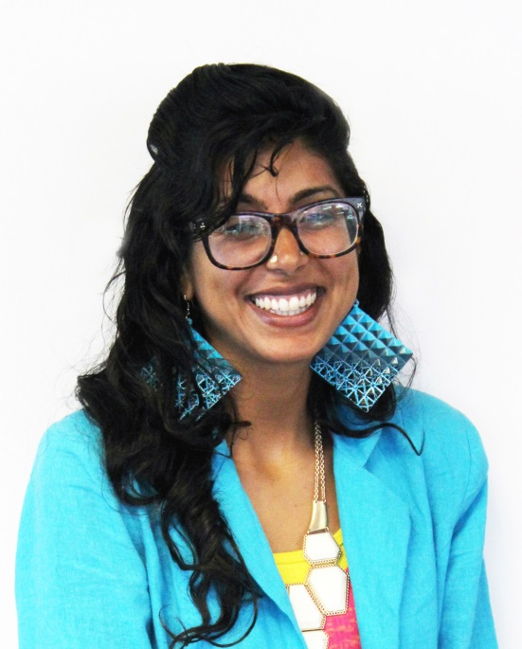
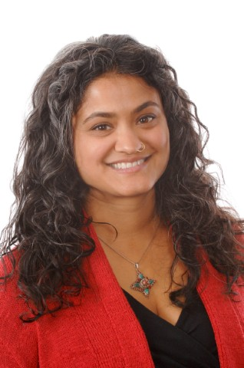
Nuri Nusrat,
Program Associate
NCCD Restorative Justice Project
sujatha baliga,
Director
NCCD Restorative Justice Project
Notes:
Leona
sujatha Bio:
sujatha baliga’s work is characterized by an equal dedication to victims and persons accused of crime. A former victim advocate and public defender, sujatha was awarded a Soros Justice Fellowship which she used to organized a successful restorative juvenile diversion program in Alameda County. sujatha is a frequent guest lecturer at universities and conferences, has been a guest on NPR’s Talk of the Nation and the Today Show, and her work has been profiled in the New York Times Magazine. She often speaks publically and inside prisons about her personal experiences as a survivor of child sexual abuse. Today, sujatha is the director of the Restorative Justice Project at the National Council on Crime and Delinquency, where she helps communities implement restorative justice alternatives to juvenile detention and zero-tolerance school discipline policies. She is also dedicated to advancing restorative justice to end child sexual abuse and intrafamilial and sexual violence. sujatha earned her A.B. from Harvard and Radcliffe Colleges, her J.D. from the University of Pennsylvania, and has held two federal clerkships. sujatha lives with her partner of 17 years, Jason, their son, Sathya, and their sweet old dog, Django
Nuri Bio:
Nuri Nusrat is a Program Associate for the Restorative Justice Project at the National Council of Crime and Delinquency. At NCCD, she supports jurisdictions throughout California in creating and implementing restorative juvenile diversion programs. Prior to coming to NCCD, Nuri worked with the National Mitigation Coordinator for the Federal Death Penalty Project, supporting lawyers whose clients were facing death sentences. She also has experience in assisting people in dismissing their criminal convictions and working with youth with incarcerated parents. She is dedicated to serving those impacted by the criminal legal system. Nuri holds a JD from American University, an MA in Ethnic Studies from San Francisco State University, and a BA in International Development from UCLA.

Slide 20
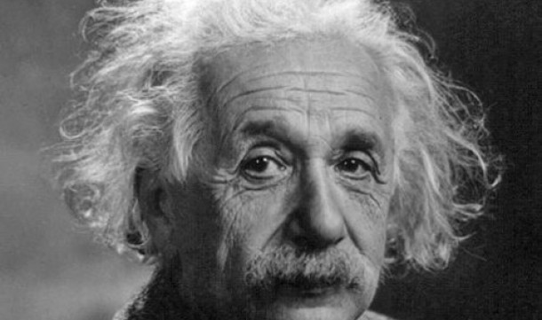
Paradigm Shift
If we want to solve a problem, we can’t continue to think the same way we were thinking when we created it.

Slide 21
What Questions Do We Ask About Wrongdoing?
What law was broken?
Who broke it?
How should they be punished?

Slide 22
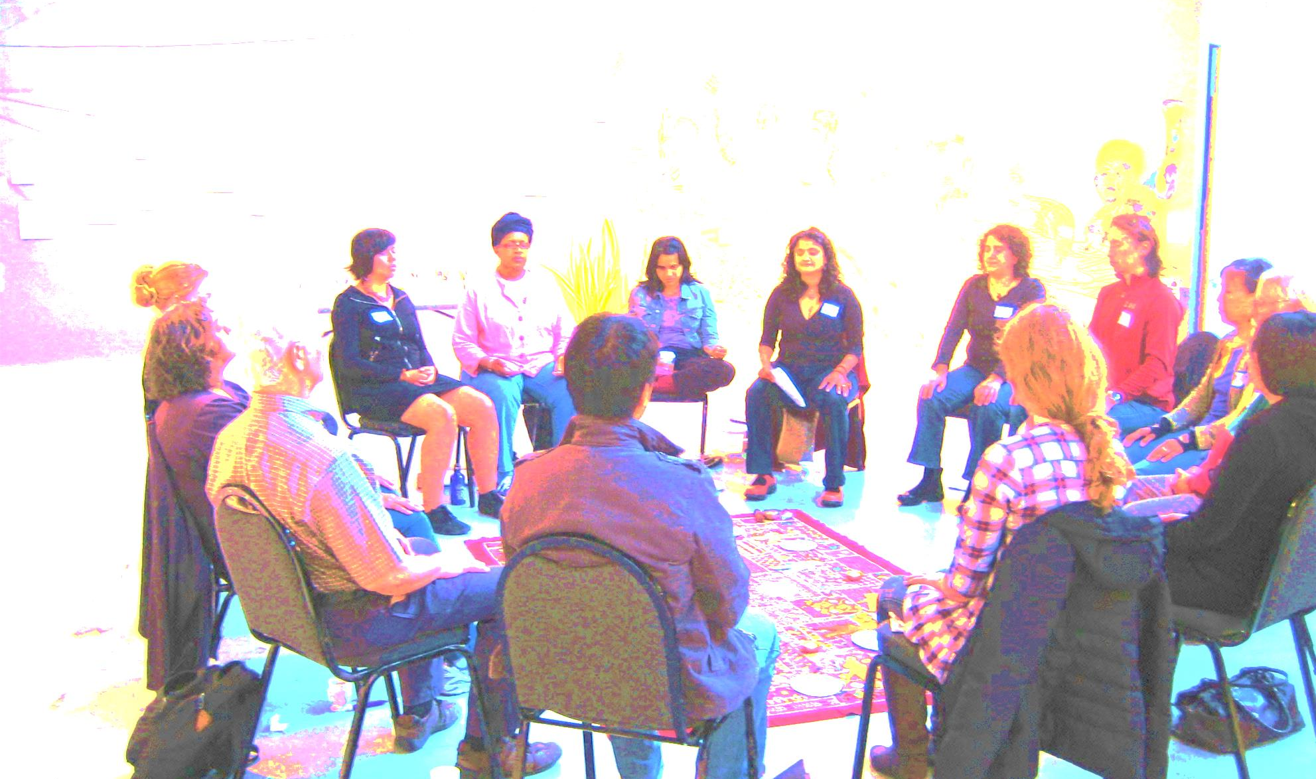
Restorative Justice Asks:
Who has been harmed?
What are their needs?
Whose obligation is it to meet those needs?

Slide 23
Who and What Do We Attend To?
Present Legal System | Restorative Justice
What law was broken? Who broke it? What punishment is deserved? ⬇ | Who was harmed? What do they need? Whose obligation is it to meet those needs? ⬇
Person who harmed | All impacted

Slide 24

The RJ (Decolonized) Golden Rule
Do unto others as they would have you do unto them.
  (To operationalize this in the wake of harm, ask:
  How were you harmed?
  What do you need?
  Whose obligation is it to meet those needs?)

Slide 25
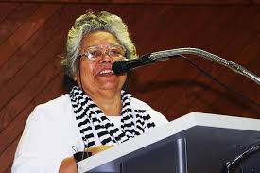
Sonya Shah’s “Fourth Really”
“If you have come here to help me, you are wasting our time. But if you have come because your liberation is bound up with mine, then let us work together.” ~ Lilla Watson

Slide 26
Why We Don’t Report
#BeenRapedNeverReported
#JusticeFailsASurvivorWhen

Slide 27
A Snapshot of Our Problem
100 Incidents of
Child Sexual Abuse
(100%)
10–18 Incidents Reported to Authorities
(10–18%)
6 People Go To Trial
(6%)
3 Are Convicted
(3%)
Adapted from Tabachnick & Klein, A Reasoned Approach:
Reshaping Sex Offender Policy To Prevent Child Sexual Abuse

Slide 28
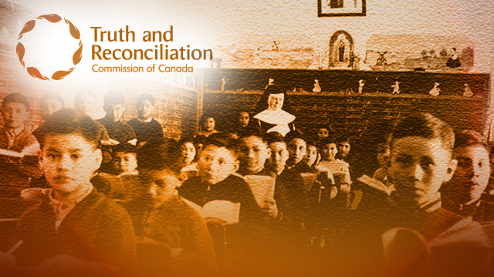
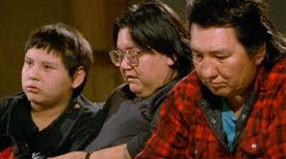
Hollow Water Community Holistic Circle Healing

Slide 29
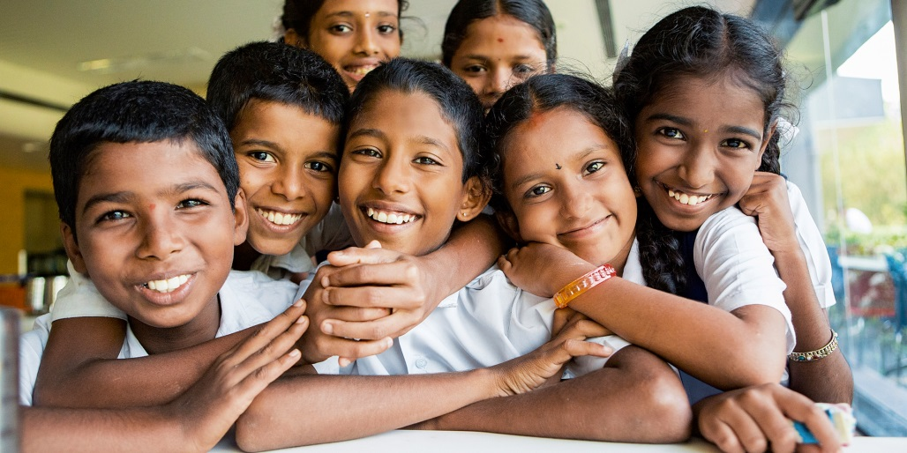
Healing Transgenerational CSA Pandemics
CSA in South Asia
  53%
  Over Half Are Boys
Diaspora Numbers?
  Links between CSA & suicidal ideation
  Inability to report

Slide 30
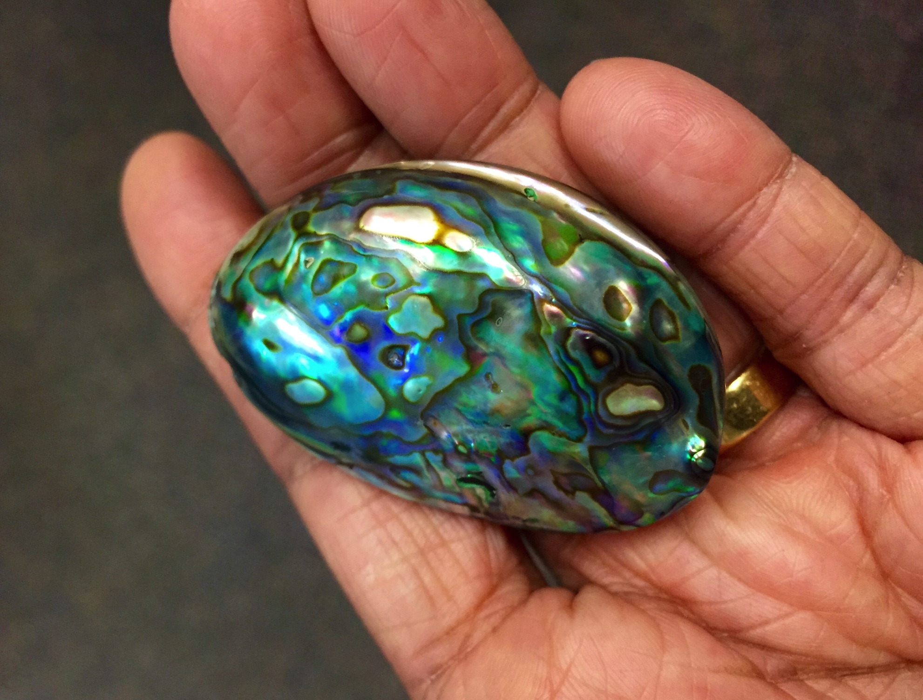
South Asian CSA Survivor Circles

Slide 31

Is There Less Abuse Here Or Less Reporting?
CSA Estimates in the United States
1 in 4 girls
1 in 6 boys

Slide 32
A Good Place to Begin
Diverting child-on-child sexual abuse cases to restorative community conferencing
Model similar to Family Group Conferencing (New Zealand Style)
A success story from Oakland

Slide 33

Exercise Extreme Caution!
Standards for Facilitating Sexual Harm Cases
Legal and collateral consequences for addressing CSA

Slide 34
Parting Restorative Justice Wisdom
Whatever affects one directly, affects all indirectly. I can never be what I ought to be until you are what you ought to be. This is the interrelated structure of reality.

Slide 35
Intersections
How would restorative justice be useful to prevention?
Notes:
Cordelia Sample audience question

Slide 36

Discussion with Speakers
Notes:
Joan

Slide 37
ONE Action
What is ONE action you can suggest?
Notes:
Cordelia 10-12 minutes before the end, ask this question

Slide 38

Notes:
Joan

Slide 39
sujatha baliga, Director
Nuri Nusrat, Program Associate
  NCCD Restorative Justice Project
  nnusrat@nccdglobal.org
Notes:
Leona

Slide 40
Next Web Conference
Preventing the Harm, Promoting the Helpful: Healthy Sexuality (January 21, 2015)
Bridging Knowledge in Child Sexual Abuse Prevention: Promising Practices in Indigenous Communities (February 18, 2015)
Pillars of Policy for Child Sexual Abuse Prevention: A Discussion (March 18, 2015)
Notes:
Leona

Slide 41

Notes:
Leona, Joan and Cordelia

